Slide 1
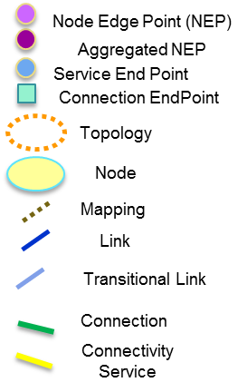
DSR Connectiviy-Service
1.D1
ODUj Client
41.D1
11.D1
DSR/
ODU
ODUk Server
DSR/ODU
51.D1
1.D2
DSR/ODU Layer
5.D2
2.D2
6.D2
1.D3
OTSi/OTSiA
2.D3
OTSI
5.D3
OTSI
6.D3
Photonic Media (OTSi/OTSiA Layer)
OTSI
OTSI
NMC
OTSi/ OTSiA Node
ROADM
OMS
ROADM
DSR/
ODU
OTS
ILA
OTS
OTSi Node
DSR/ODU
OTSi/ OTSiA Node
OMS
ROADM
OMS
OTSi Node
Photonic Media (OTSiMC, OMS, OTS) OLS Layer
Photonic Media (OTSi/OTSiA Layer)
DSR/ODU Layer

Slide 2
Media Channel
(MC)
OTSi Media Channel
(OTSiMC)
1
2
OTSi
OTSi
FREQUENCY

Slide 3
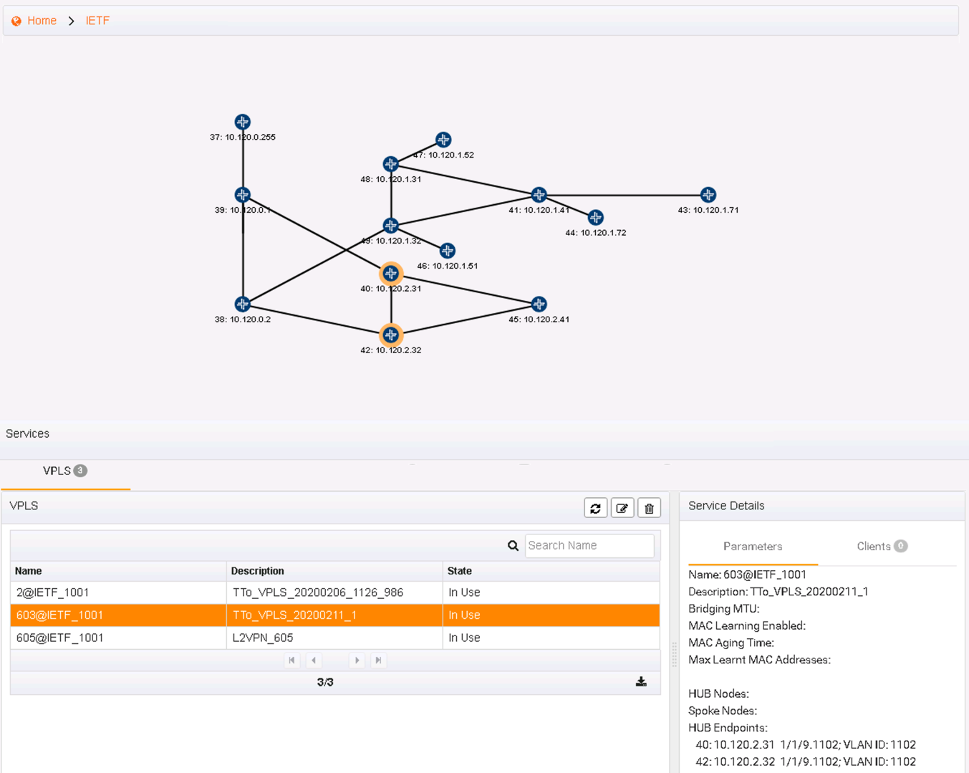
1
3
2

Slide 4
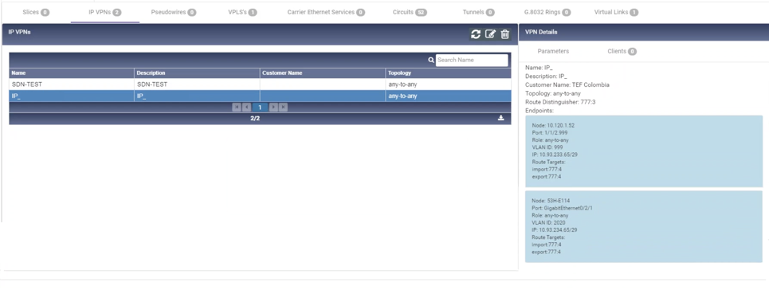
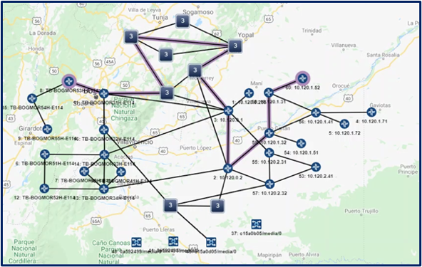
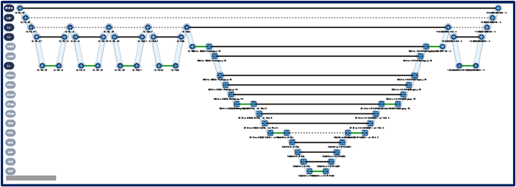
1
2
3

Slide 5
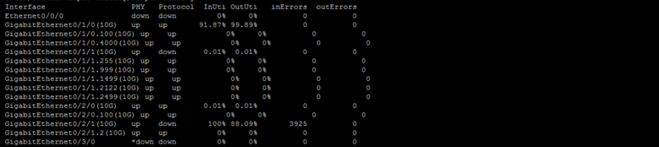
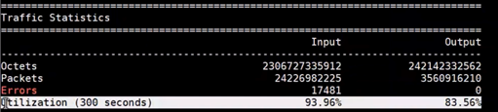
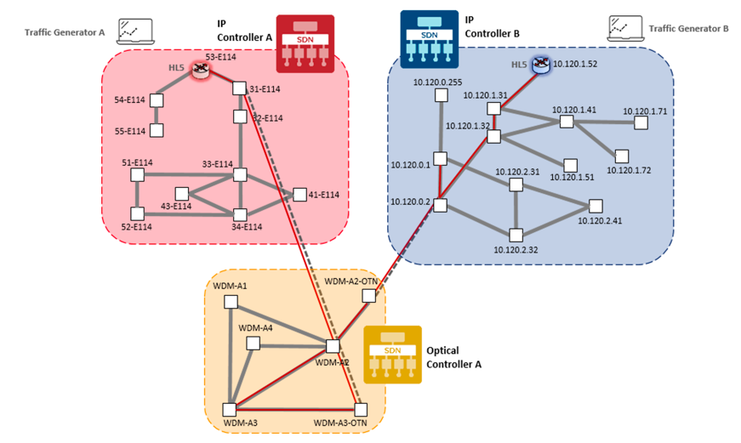
1
2

Slide 6
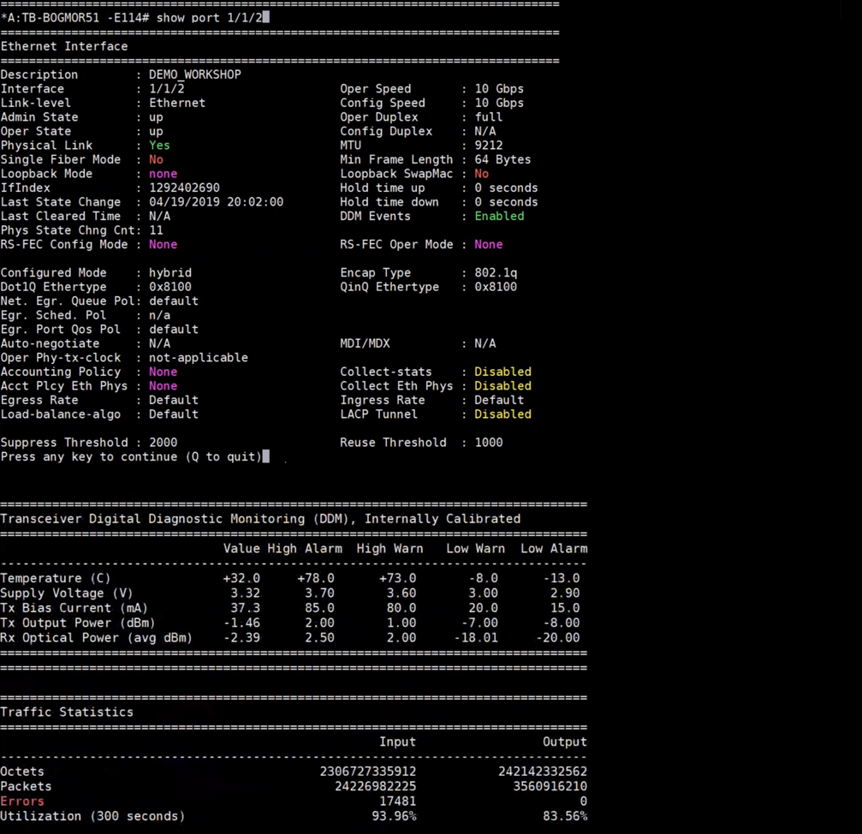
2
1

Slide 8
IE-PROFILES
VPN SERVICE
VPN SERVICE
VPN NODE
L3NM
L2NM
SITE-NET ACCESS
SITE-NET ACCESS
SITE
SITE
SITE BEARER
SITE BEARER
a) L3MN
b) L2MN

Slide 9
1
2
3
4

